Slide 1

Kotlin for Android
A suitable replacement to Java for Android at Heritage College?

Slide 2
Agenda
What is Kotlin?
Java Syntax vs Kotlin Syntax
The (Monetary) Cost of Kotlin
The (Performance) Cost of Kotlin
Documentation Availability
Kotlin’s Staying Power
Kotlin and the Job Market
Conclusion

Slide 3
What is Kotlin?

Slide 4
What is Kotlin?
Programming language created by JetBrains (ReSharper, WebStorm, PhpStorm, and more)
Developed because they felt no other Java alternative was appropriate for their work
Can be used in several environments:
  The Java Virtual Machine (JVM)
  Android, via the Android Runtime (ART)
  The Browser, via transpiling to JavaScript
  Compiled to native binaries
Boasts being both more concise and safe than Java

Slide 5
Java Syntax vs
Kotlin Syntax

Slide 6
Java Syntax vs Kotlin Syntax
The most obvious difference between Java and Kotlin
Kotlin chooses to make assumptions, rather than expect the developer to be explicit
Drastically reduces the amount of boilerplate code that Java is infamous for
Introduces new concepts that are not yet in/have only recently been added to Java:
  Lambda functions
  Higher-order functions
  Safe-call operator
  Extension methods
Official plug-ins improve Android specific syntax

Slide 7
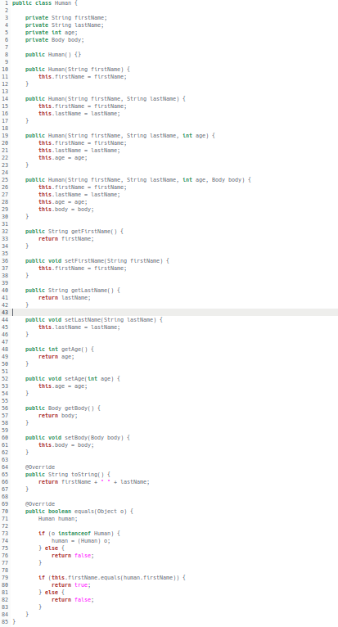


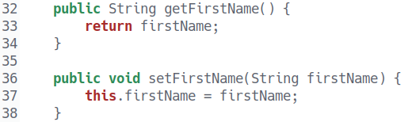

Generic Java Class Example

Slide 8

Kotlin Class Example
Only 92 characters, can fit on one line
Handles getters, setters, equals(), hashCode(), toString(), and copy()

Slide 9
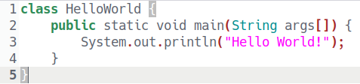
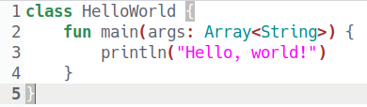
Hello World Comparison
Java
117 Characters
Kotlin
94 Characters

Slide 10
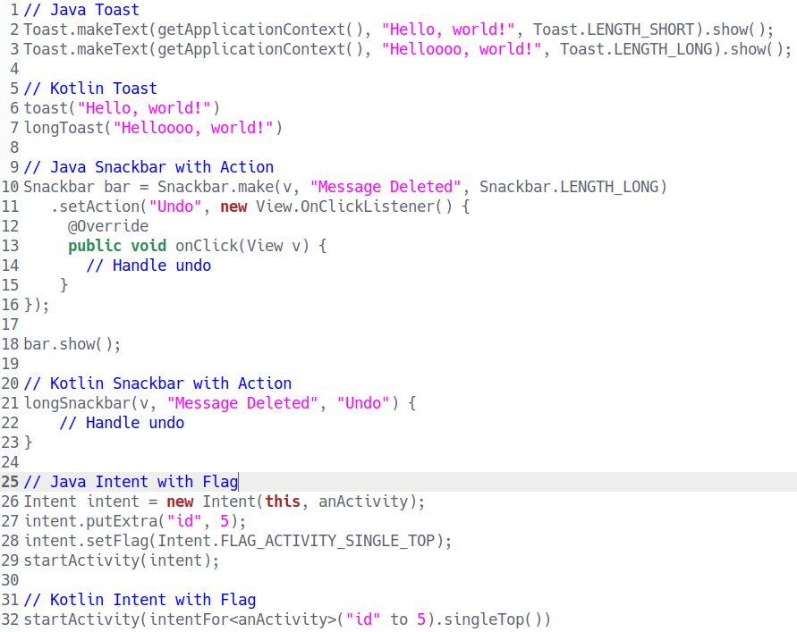
Android Specific Examples
Changing the text of a TextView
Java
Kotlin

Slide 11
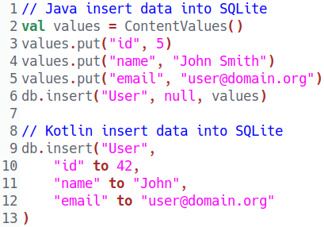
Android Specific Examples

Slide 12
The Cost of Kotlin

Slide 13
The (Monetary) Cost of Kotlin
Open sourced under the Apache 2.0 license
Boasts usability with any Java IDE
  In reality, not integrated with all Java IDE’s
  Stand-alone command line compiler can be used with any text editing program/IDE
Several free supported Java IDE’s:
  Eclipse (With a free plug-in)
  Android Studio 3.0 / IntelliJ IDEA Community
No monetary cost required

Slide 14
The (Performance) Cost of Kotlin
Specific situations have an increased execution time:
  Spread operation execution time doubled
  Delegate properties increased by 10%
  forEach loop increased by 300%
Occurs on both the JVM and ART
Full compilation times increased by 10% to 15% with Kotlin
Partial compilation time faster on average with Kotlin
  Arguably is more common than full compilation
Is the more terse syntax worth possible performance loss?

Slide 15
Documentation Availability

Slide 16
Documentation Availability
Both Kotlin and Java have a large repository of official documentation available online
Because of it’s age and wide enterprise usage, Java has an expansive library of community documentation
Inversely, Kotlin has yet to build up community documentation that is anywhere near as large

Slide 17
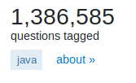



Documentation Availability*
Difference of 1,378,135
Difference of 200,089
*As of March 11th, 2018

Slide 18
Staying Power

Slide 19
Kotlin’s Staying Power
End of 2017 reports by Stack Overflow and GitHub show that Kotlin’s popularity has yet to grow to mainstream levels
Software development company Realm’s 2017 Q4 believes that Kotlin will rise to 50% market share by the end of 2018

Slide 20
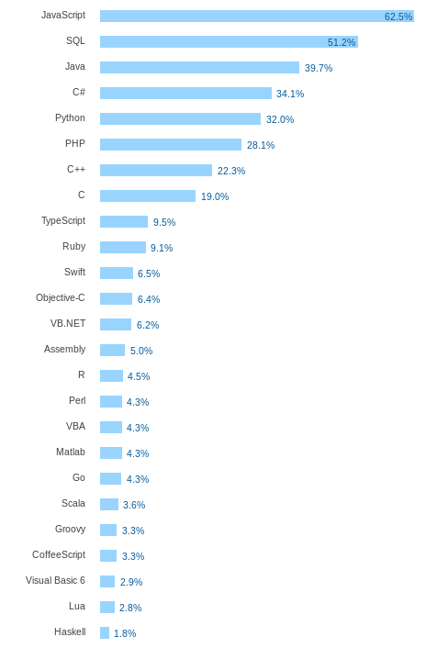
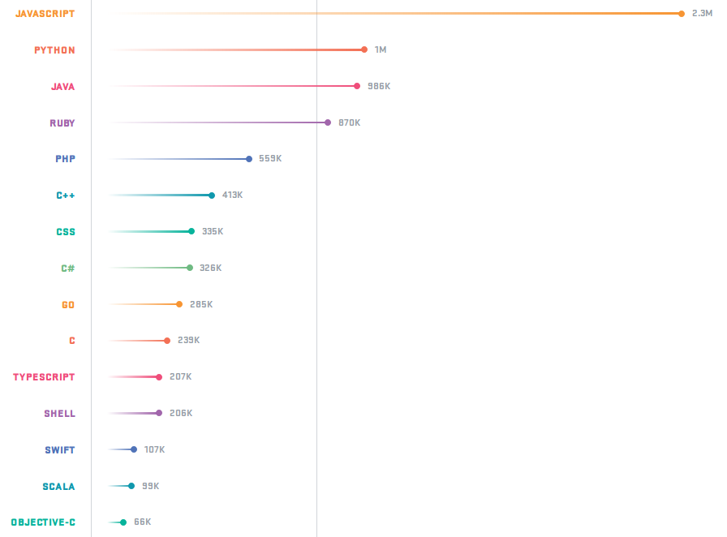
Kotlin’s Staying Power
GitHub
Stack Overflow

Slide 21
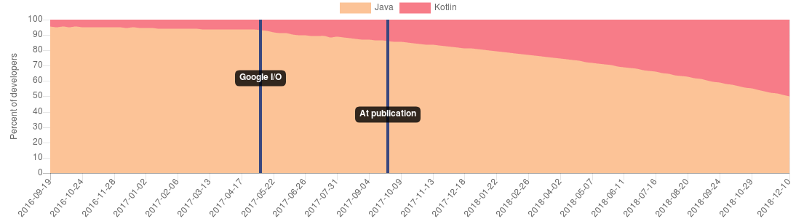
Kotlin’s Staying Power
Realm Q4 Trend Report Kotlin projection

Slide 22
Kotlin and the Job Market

Slide 23
Kotlin and the Job Market
In the Outaouais area, very little Kotlin jobs are available
Indeed has only three jobs looking for Kotlin experience*
  Only one job was for a developing a Kotlin application
Government of Canada Job Bank shows no jobs looking for Kotlin experience*
*As of March 11th, 2018

Slide 24
Conclusion

Slide 25
Conclusion
Kotlin is an extremely efficient way to write Android applications
Performance loss exists, but may be worth the decrease in development time
Documentation is available, but community support is currently low due to it’s infancy
Is not as popular as other Java alternatives, but is estimated to increase by 2018
Local job opportunities are scarce, however that will change if popularity increases

Slide 26
Conclusion
While Kotlin is a fantastic language for Android development, at this time Kotlin does not enhance a students chance of becoming employed after graduation. Because of this, Kotlin should not become the official language for Android at Heritage College. If Kotlin should rise to become a dominant Android language, then a serious consideration for Kotlin should be made.

